Slide 1
Voice of America
Mandarin Mobile App Comparative Analysis

Slide 2

Pear Video

Slide 3
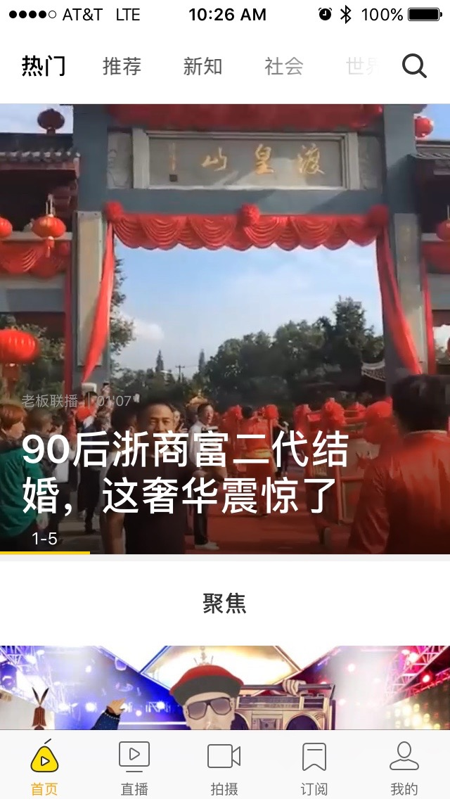
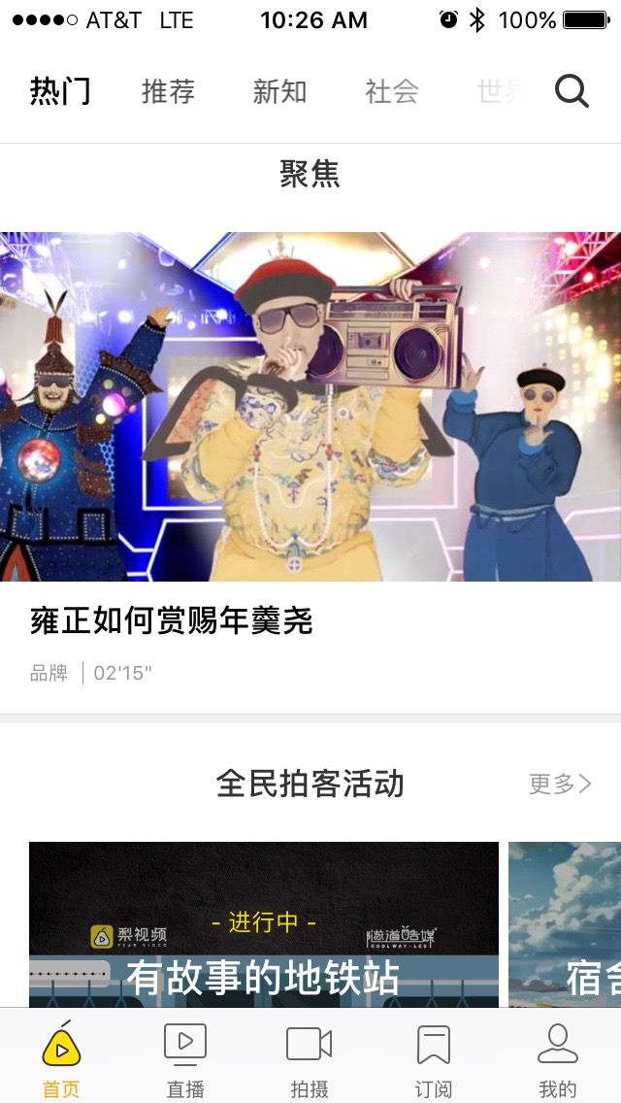
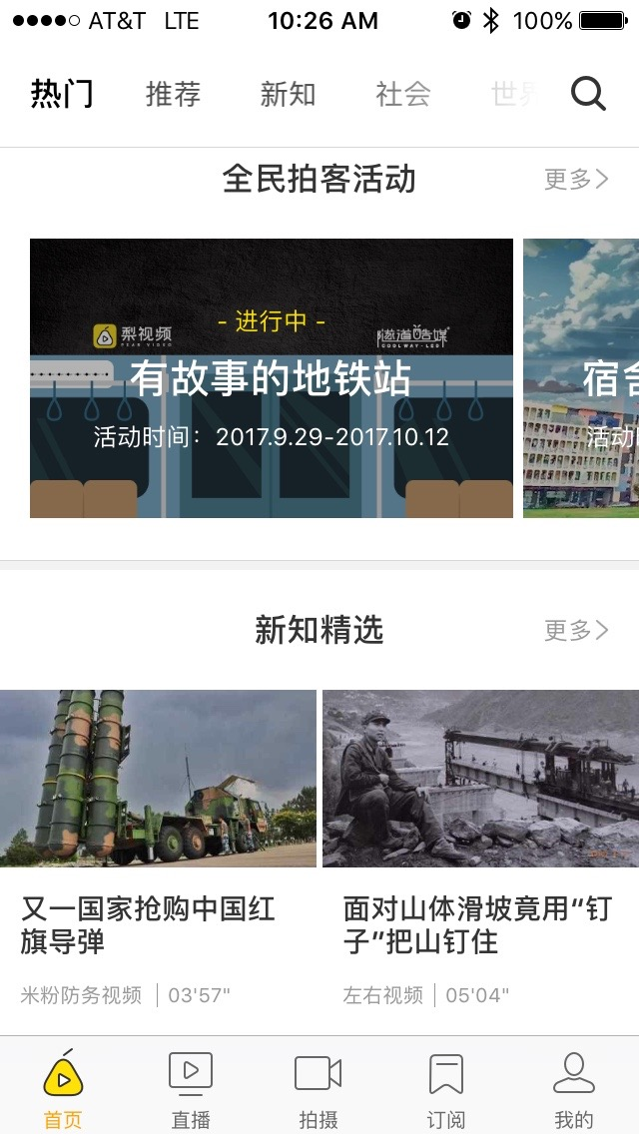
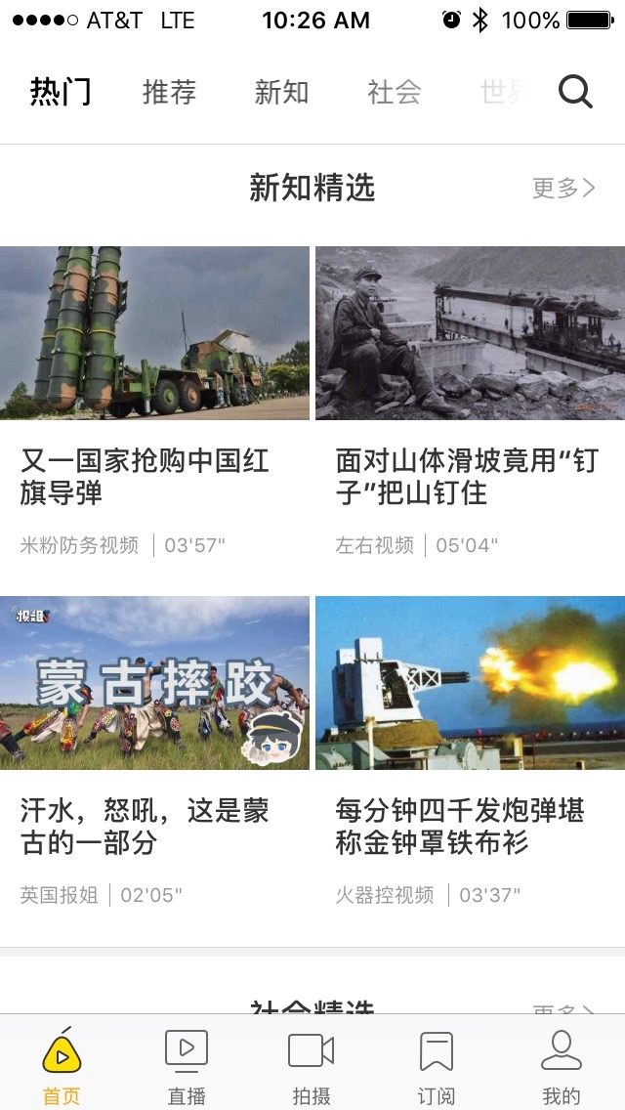
Pear Video: Home Screen
Home Screen
Top hero box video loop (1 of 5) with white title text overlaid at the bottom.
Clicking video loop pushes it up to the top of screen and starts loading full video.
Horizontal swipe to the left reveals next video loop.
Second order image for video with black title text below, “Live Video” above.
Clicking image pushes it up to the top of screen and starts loading video.
Horizontal swipe to the left navigates to the next category from the top nav.
Swiping down from landing page updates content.
Third order images for videos with black title above and white text overlaid. Additional images bleed off to the right indicating more available with horizontal scroll.
Clicking image brings up new screen with image at the top of screen and starts loading video.
Horizontal swipe to the left reveals next image.
Fourth order images for videos with black title above. Videos are organized in a grid.
Clicking image pushes it up to the top of screen and starts loading video.
Horizontal swipe to the left navigates to the next category from the top nav.

Slide 4
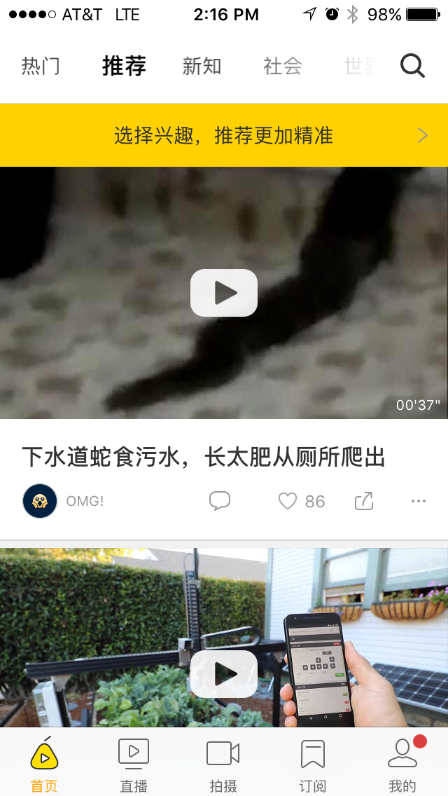
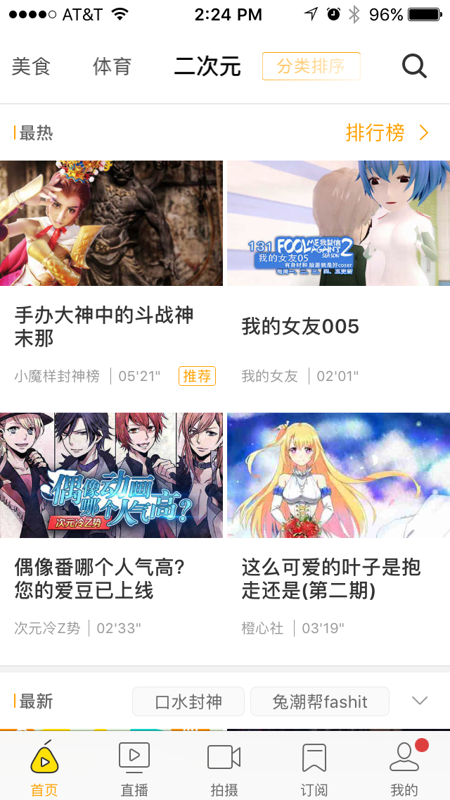
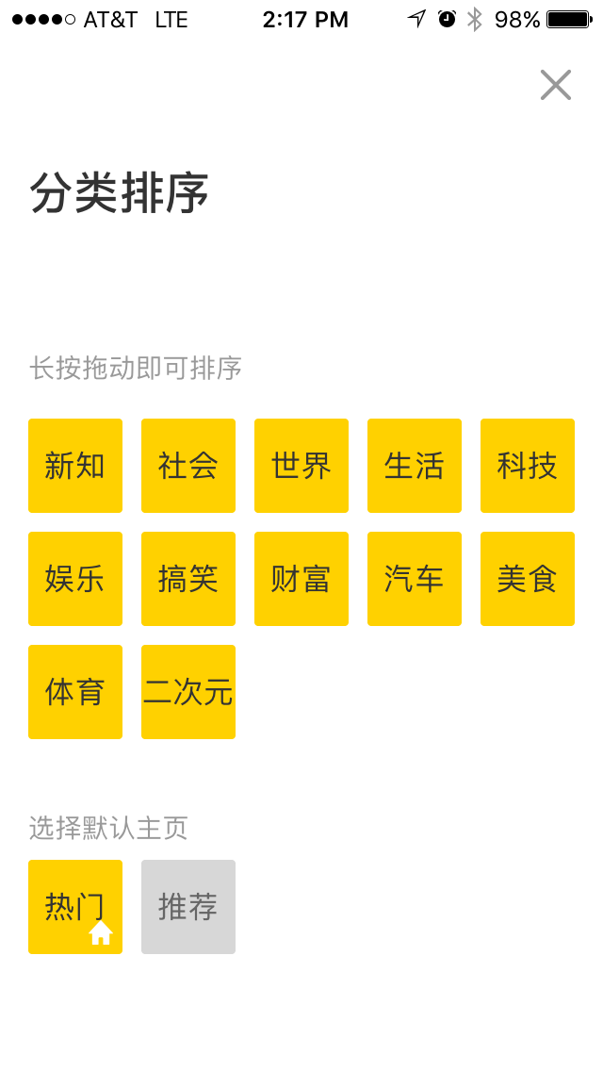
Pear Video: Top Navigation
Home screen with first “Trending Videos” automatically selected.
Swiping the top nav categories to the left scrolls them. The right most category is slightly greyed to indicate more categories to the right.
On the home screen, swiping the 2nd order and 4th order images to the left is the same as selecting the next category .
Editor’s Choice
The user has the ability to choose which order they want to see the Trending Videos vs. The Editor’s Choice
The user can order 12 separate categories based on preference such as:
The World
New Info
Comedies
Sports
Foods
Cars
Technology
etc.
The 12 categories on the top of this screen can be reordered.
The home screen can be assigned to one of the two bottom categories on this screen.
This screen can also be revealed by swiping right from the home screen.

Slide 5

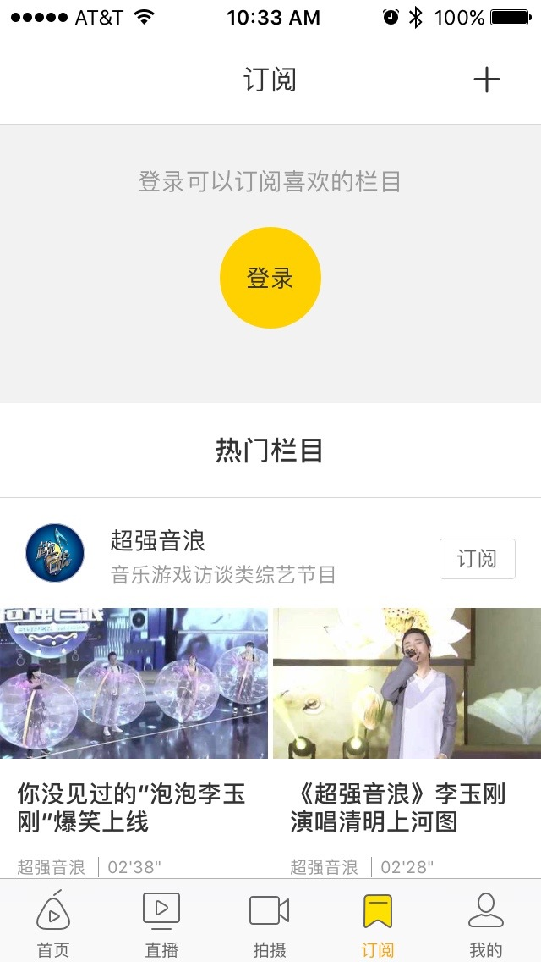
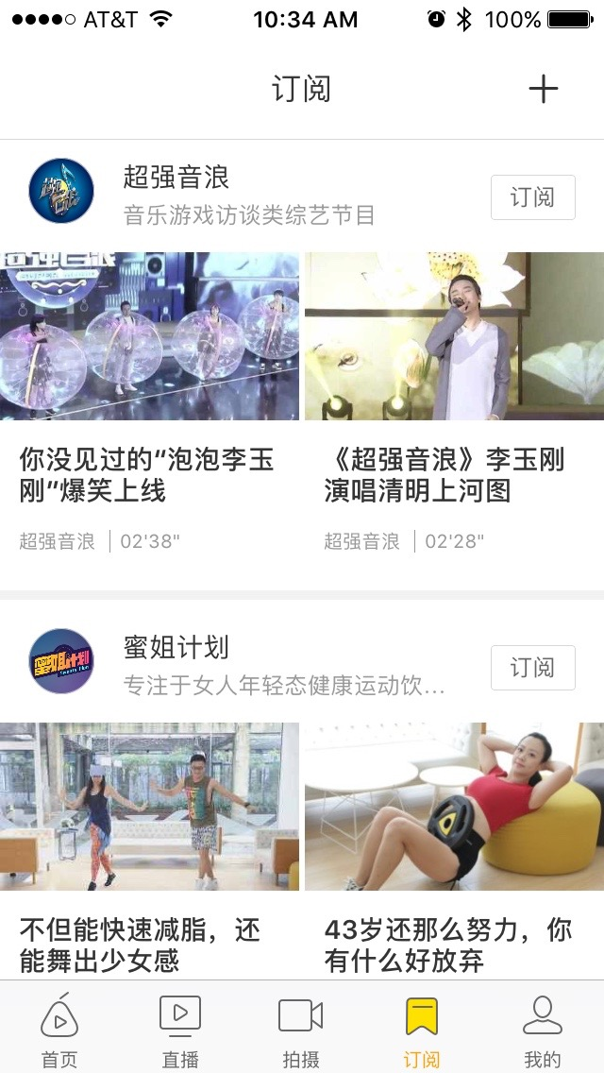
Pear Video: Additional Screens
Live Stream
Image for video with black title below and additional white text overlaid. (inconsistent)
Top video is live or on-demand if it has played already. Top left white text on video is the date of broadcast.
Following videos are upcoming. Includes ability to get a notification of the broadcast.
Also includes videos that have been broadcast that you can view on-demand.
Top right allows you to edit your notifications. Need to sign up first.
Subscriptions to Other Channels
Subscribe to other user’s channels.
Includes featured users and their content. It’s possible the featured channels are either paid or very popular.

Slide 6
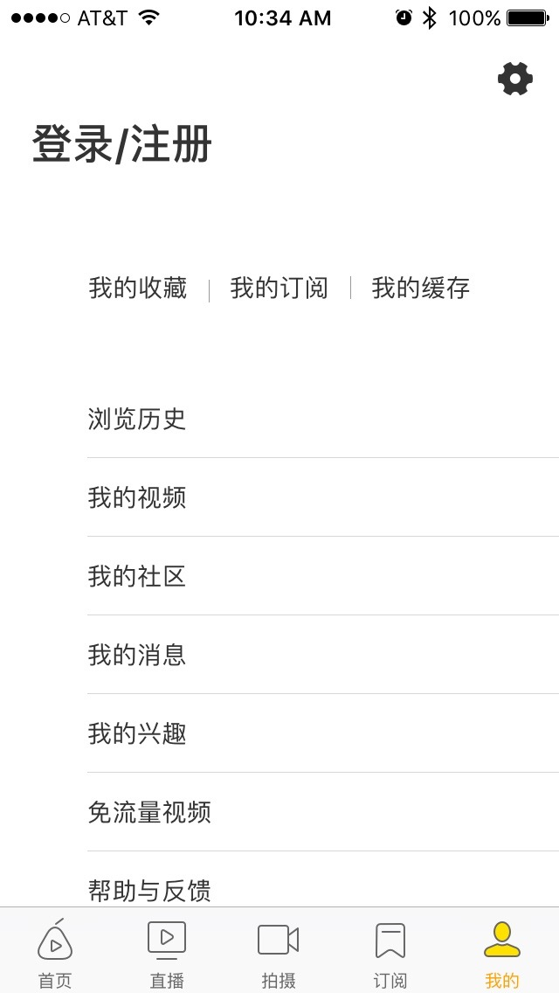
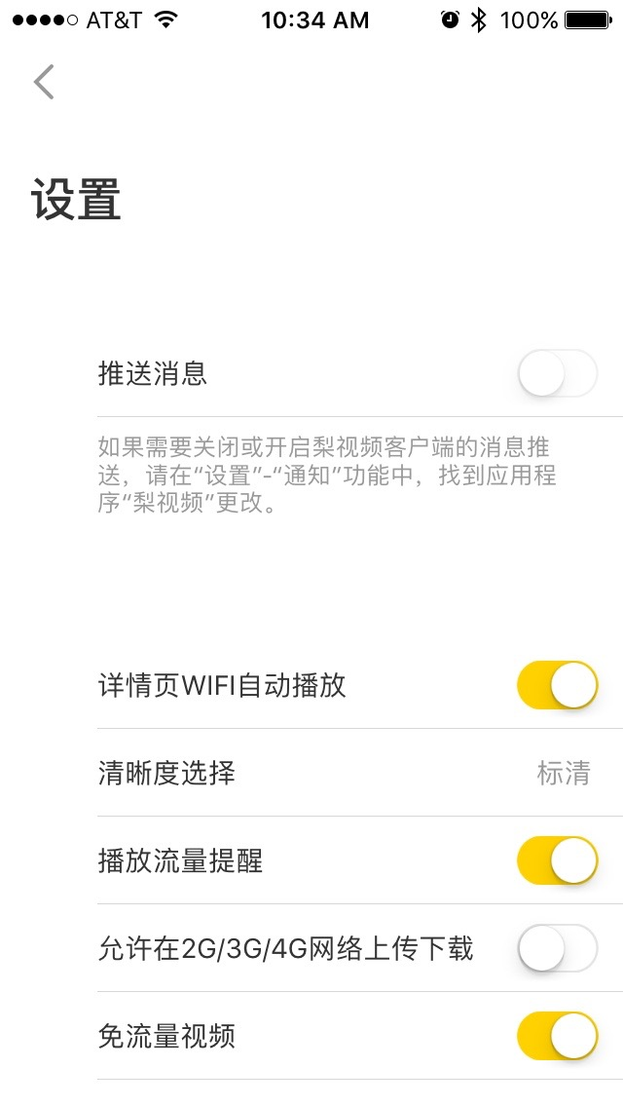
Pear Video: Personal Settings
Personal Settings
Across the top
Favorites | My Subscriptions | Available Space for Downloading
List of options:
Browsing History
My Videos
My Community (Groups)
System Updates (version of app) → Push Notifications history (they recommend two pushes a day)
What I like: Self identification for customization (gender, topics I like, etc.) → ask if you want recommendations from this on home screen
Allow cellular download
Help and feedback → FAQs and post a question
Enable push notifications
Auto play when on Wi-Fi
HD or SD resolution
Reminder on how much bandwidth you’re using
Enable 3G/4G uploads/downloads
Use cellular data (not shown)
Clean temporary cache? (not shown)
Select which social media channels for sharing
WeChat
Friends Group
QQ Friend
QQ Space
Sina Weibo
iPhone share
Copy link
Favorites
Choose home screen
Rate the app
About us

Slide 7
Pear Video Key Findings
Home Screen
Four ”hero” images plus indicator
Personal Settings
Self-identification for personalized content
Enable cellular download
Enable push notifications
Share the app
Send Feedback
Categories
Categories across the top with indicator to scroll left for more
Ability to order and remove categories from navigation
Navigation
Swiping left navigates to next category
Swiping right from within content navigates back/up in hierarchy
Swiping down from landing page updates content
Header and footer stay static
Video Player
”Push” video’s image to the top of the screen and load player
Very thin horizontal bar across bottom shows progress of video
Swiping video up or down to control volume

Slide 8

Xinhua News

Slide 9
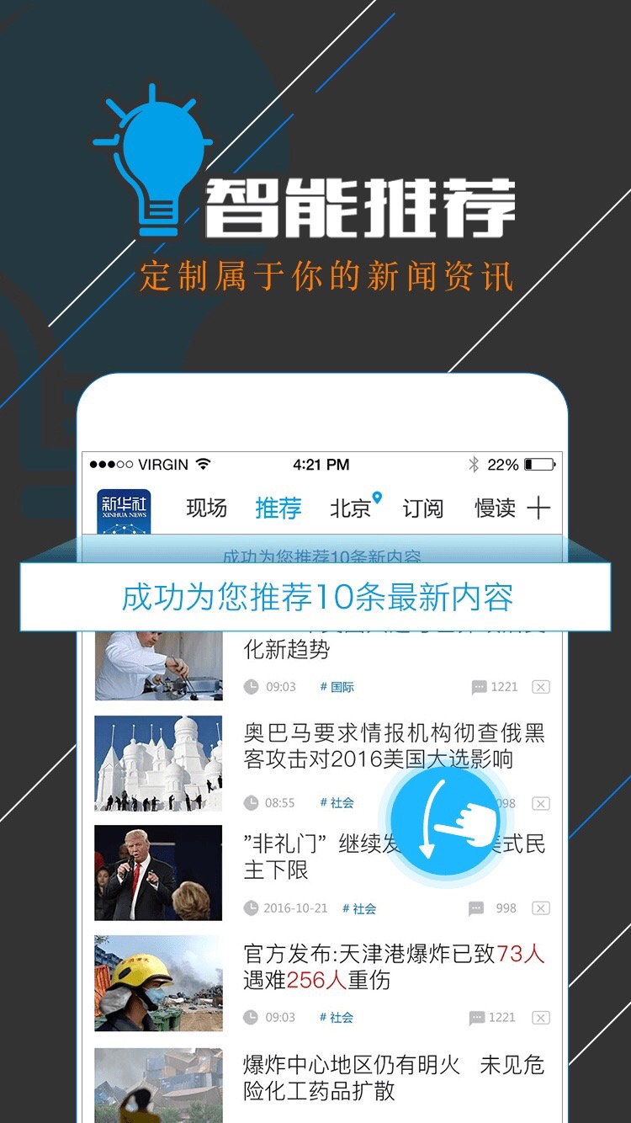
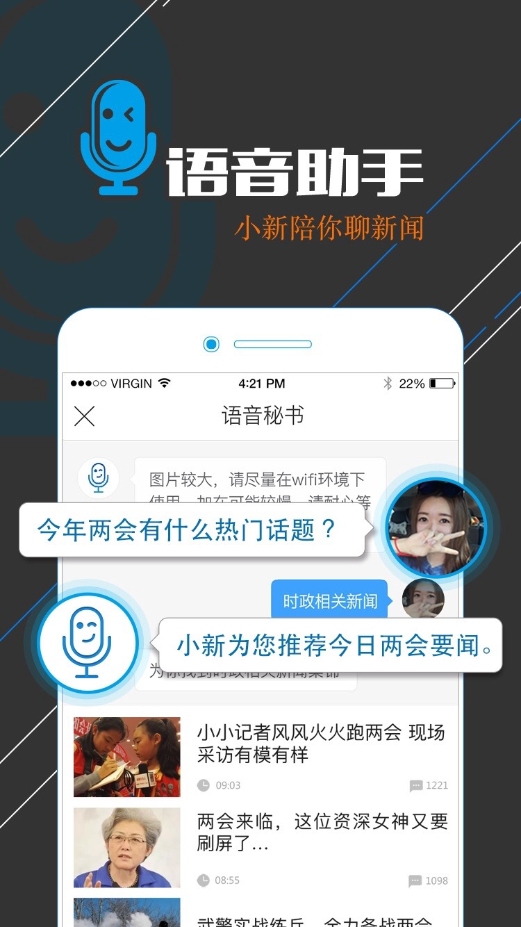
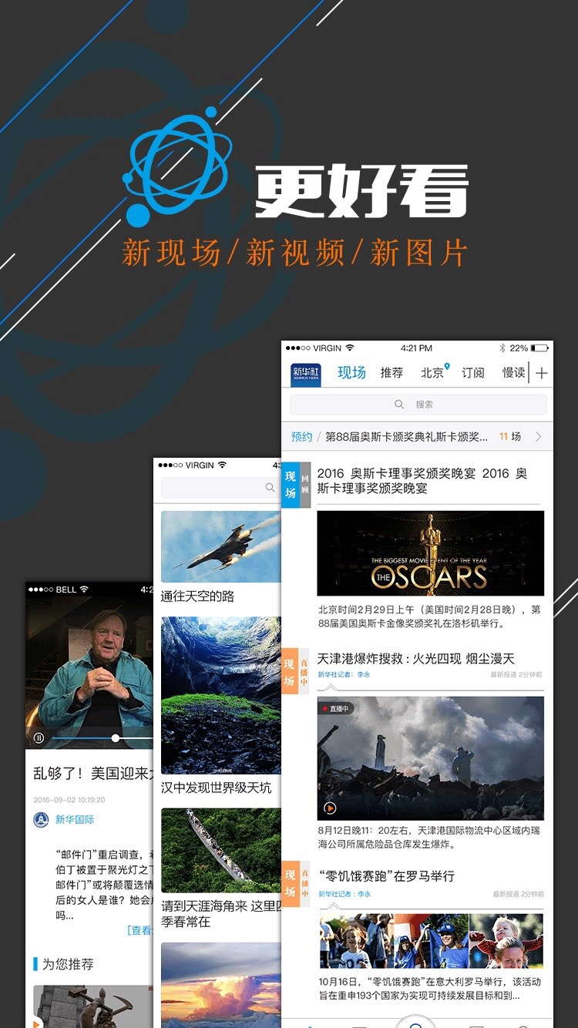
Xinhua News: Onboarding
Onboarding
Xinhua uses splash screens to introduce new features when the user first opens the app
“Swiping down refreshes the screen and loads the most recent or relevant content.”
“Use this to get voice activated help in Mandarin”
Includes voice search in Mandarin
Real time communications:
BTW, walkie-talkie capabilities are popular which We Chat enables
Xinhua provides different content types:
Live content
video
photo galleries

Slide 10
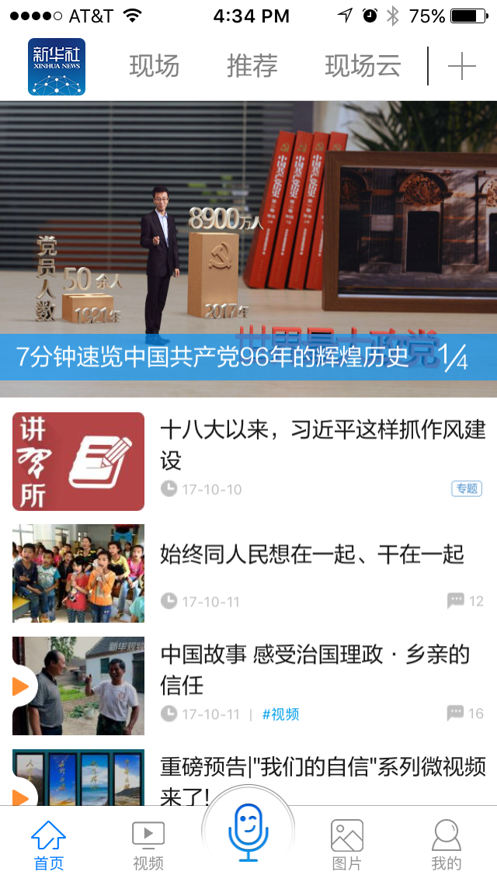
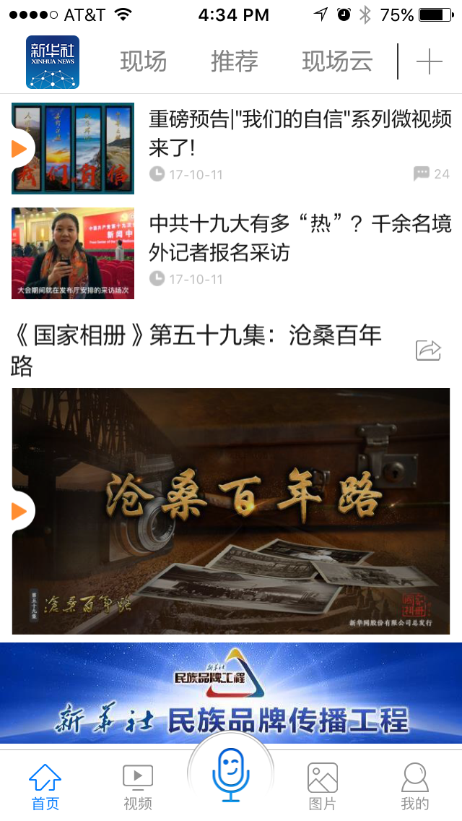
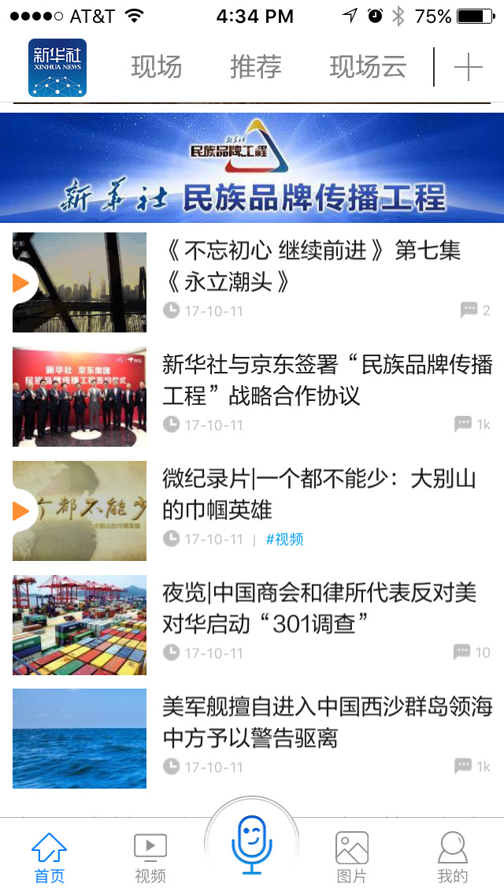
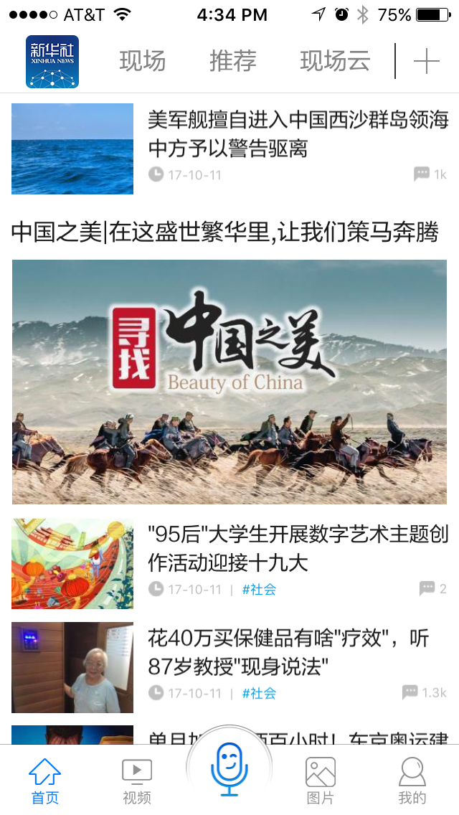
Xinhua News: Home Screen
Home Screen
Four images in carousel. Transitions are very nice – blue band scrolls but images just cross fade
Following images are top priority stories. Blue link is a hashtag. Grey flag is number of comments.
Swiping down from landing page updates content.
Large image is programmed content. Black text above says it is “Episode 59 of 60.”
Blue graphic is a promotion for other inter-related video content.
Continued list of high-level related content – tagged similarly. Larger blue link (not show) goes to “Read More” for more related content.
Header and footer stay static.
More promoted content
If the smaller thumbnails don’t have a blue divider link, they are not related – merely ongoing stream.
White space is not appreciated.

Slide 11
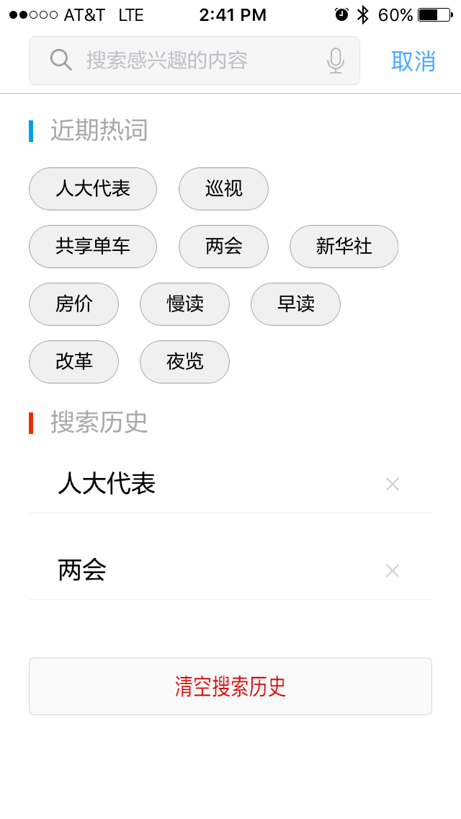
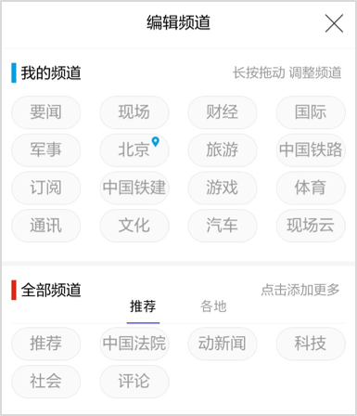
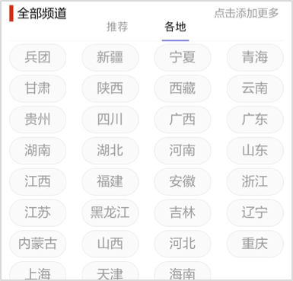
Xinhua News: Categories and Search
Channels / Categories
+ sign gives access to controlling channels
List of channels that user can reorder.
Blue bar = “My Channel”
Clicking channel in blue section pushes it down to red section and takes it off of top nav.
Red bar = “All Other Channels”
Left group is news channels
Right group is geographic locations
Red text at the bottom (not shown) more locations.
Clicking channel in red section pushes it up to blue section and adds it to top nav.
Search Screen
Access by swiping down on any category screen (not shown). Blue text in upper right is “Close”
Type or speak search terms
Blue bar is popular search terms
Red bar is search term history. Red text is “Clear History”

Slide 12
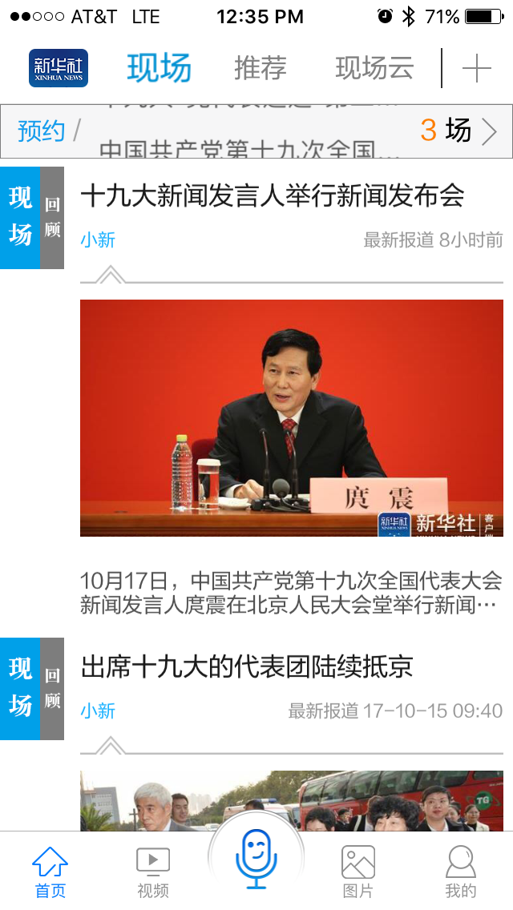
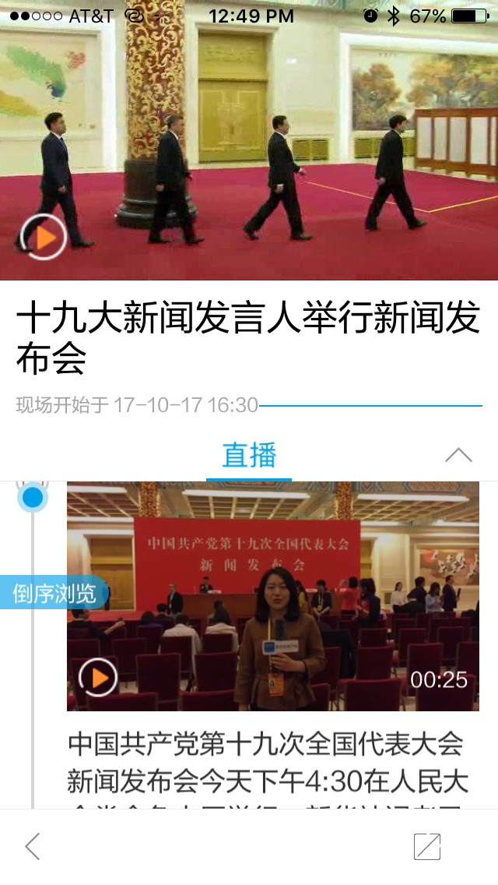
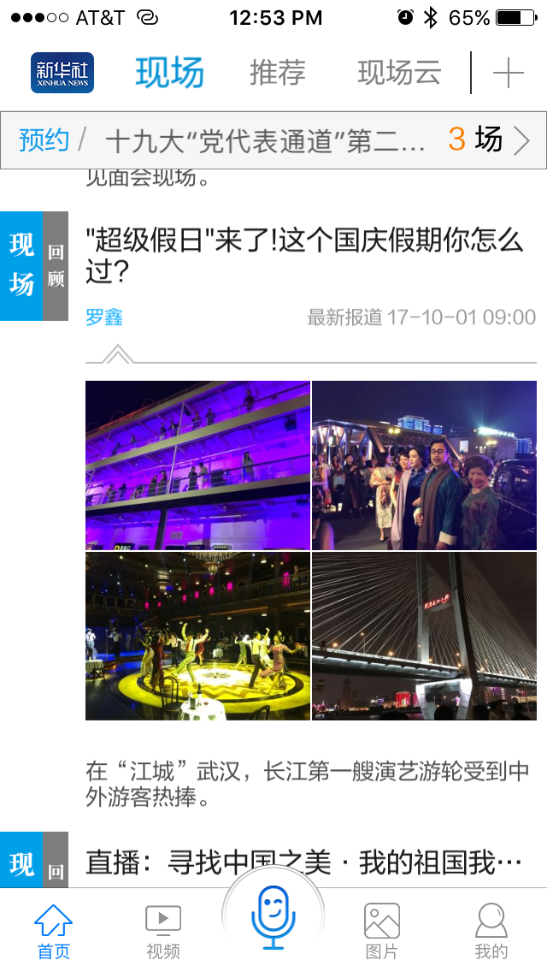
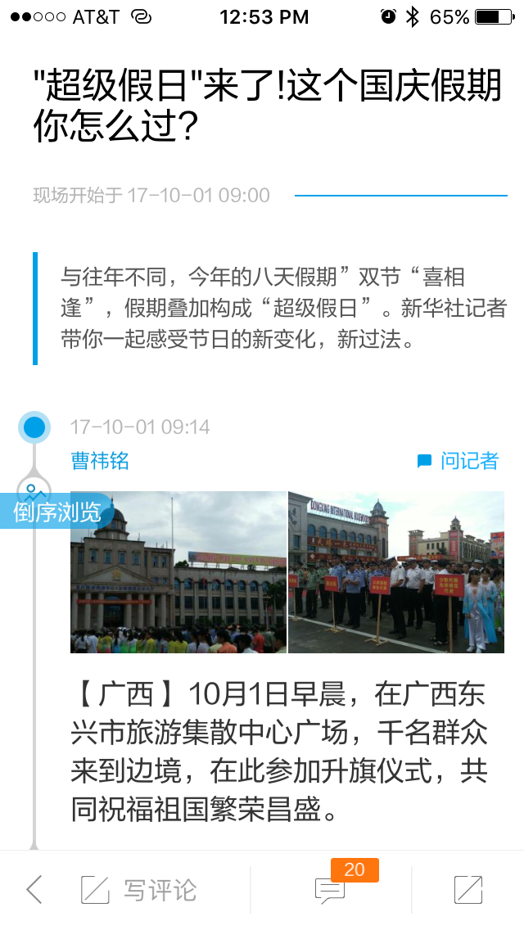
Xinhua News: Live Stream Category
Live Stream (just video) / Blog
Swiping down says “Loading Content”
Top bar with yellow “3” on the right shows list of upcoming live streams. Click one of them to add it to your calendar / notifications.
Video with red backdrop was broadcast and is now on demand. Top black text is topic of live stream. Light grey to the right is the time it was broadcast.
Blue rectangle with white text on previous screen is an icon for “live stream” Grey rectangle is ”on demand”
Blue text to the right is “recent”
Grey text below video is the teaser.
Top teaser image is the same as red video on previous screen. Clicking it plays video.
Below is related Live blog: portfolio of Images, video, and text from on-site.
Some of the teaser content shows several images from the live blog.
VOA has live blog articles that are separate from news article content.
All related content image linked from previous screen. More static images, short videos, and live blog.

Slide 13
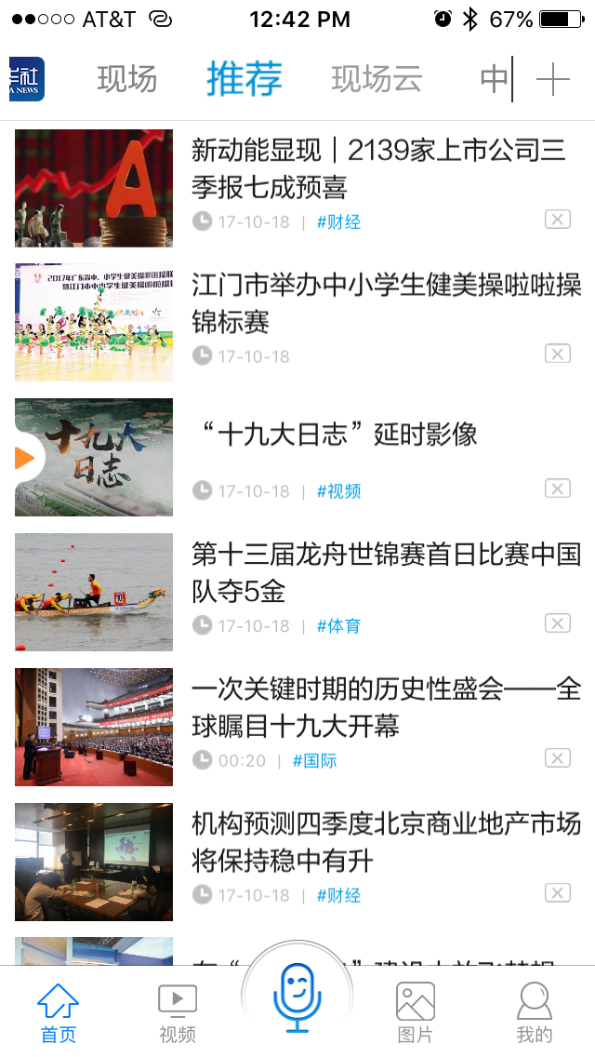
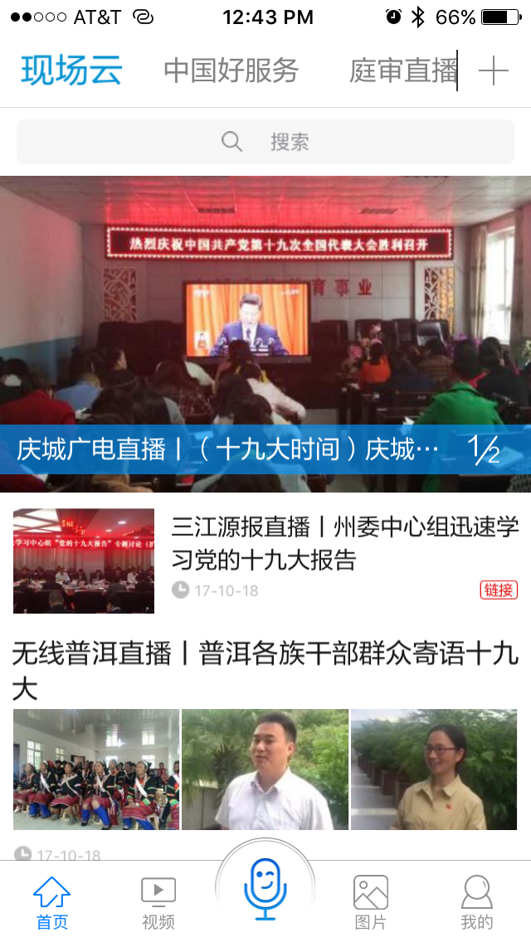
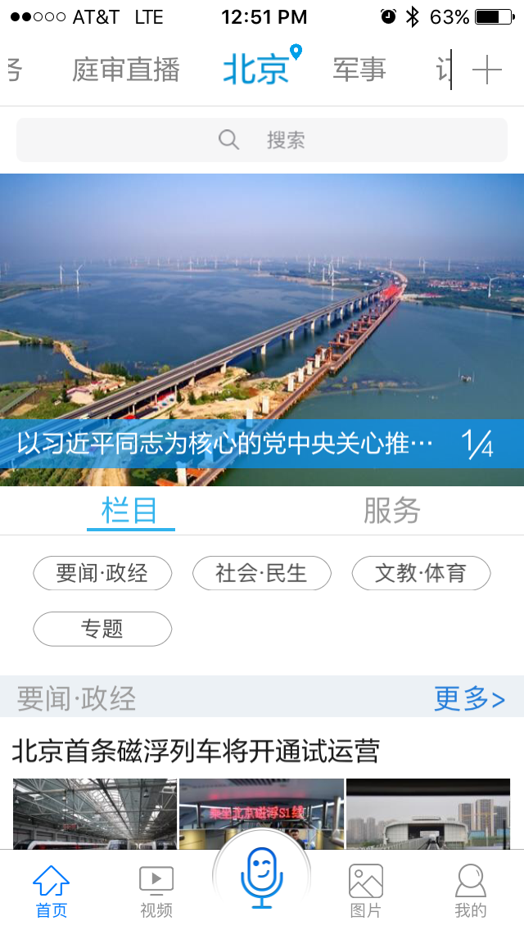
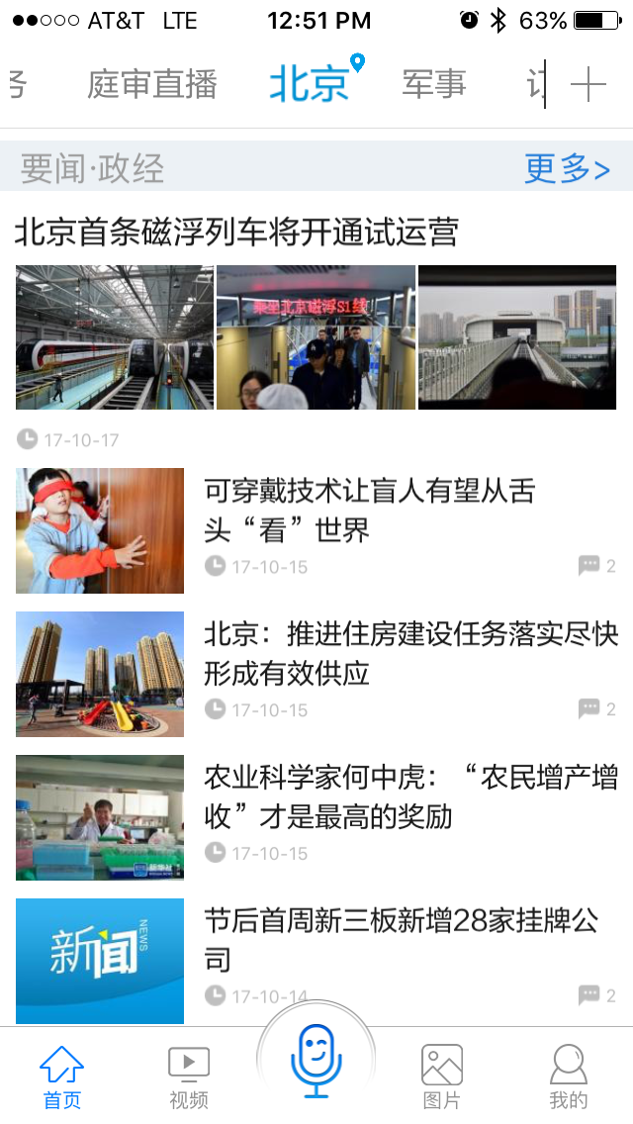
Xinhua News: Categories continued
Recommendations
Editor’s picks. Could be recommended based on profile.
Cloud / Sourced from other News Agencies
Top story
Second story
Third story from local news – 3 images side by side link to a mix of multimedia content
Beijing ”Location” Category
First image is lead story
Highlighted blue tab lists tags (4 buttons here) that jump down to categories under Beijing
Un-highlighted grey tab lists links such as movie theatre listings
Content under particular category. Grey bar is category title and blue “read more”
Five articles listed at a time. Then “read more” at the bottom of the category then next grey category bar.

Slide 14
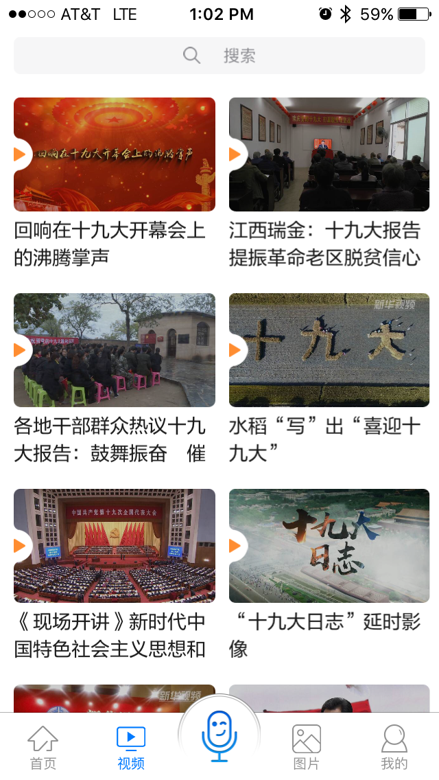
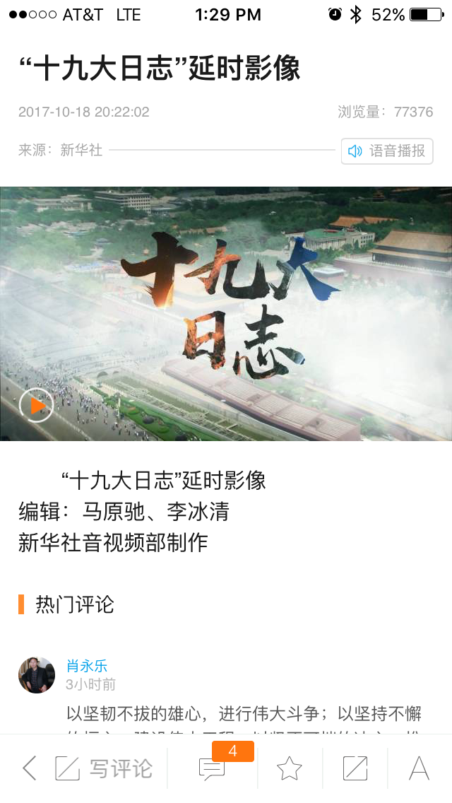
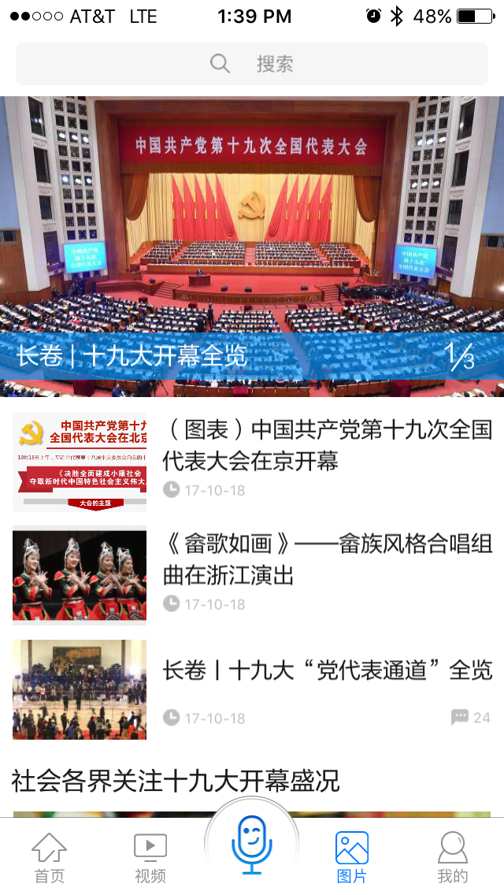
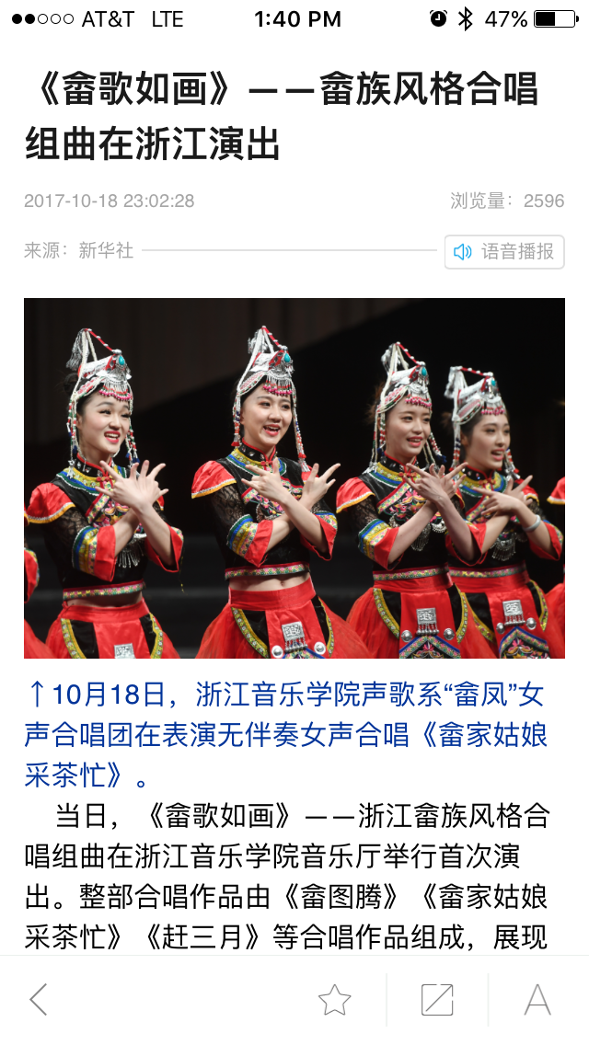
Xinhua News: Video and Photos
On-demand Video
Orange triangle on the left is similar to white triangle on YouTube videos
Bottom has Back button, leave comment, read comments favorites, share, font size
This is hidden on swipe up and revealed on swipe down
Video Details
Title of video
Upload date and time
Number of views
Audio Only selector
Video image
Teaser
By line
Comments
Ability to just listen to audio in the upper right.
Photo Gallery Collection
Next page will have associated group of photos and captions (not shown)
Top black text is specific name / subject of the photo gallery
Small light grey is date and page views
Next small grey line is source (local agency)
Blue speaker =Machine reader for all the text
Caption
Intro teaser

Slide 15
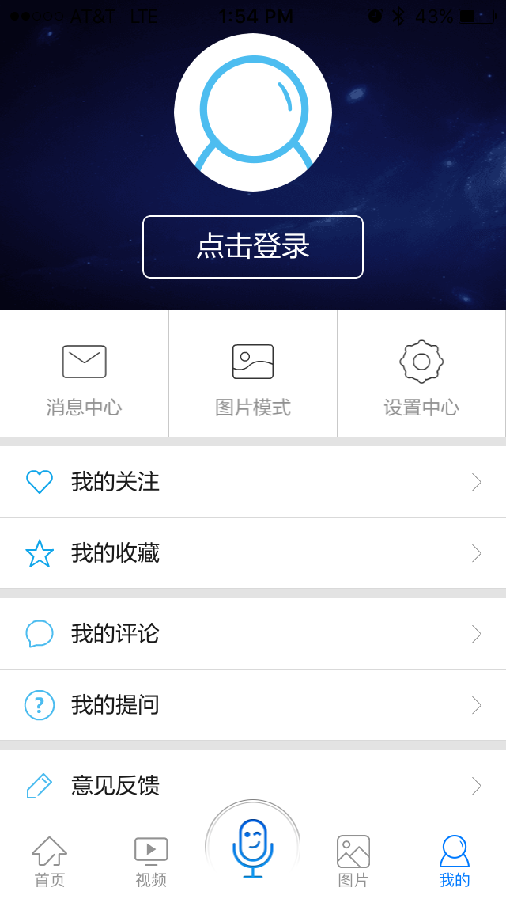
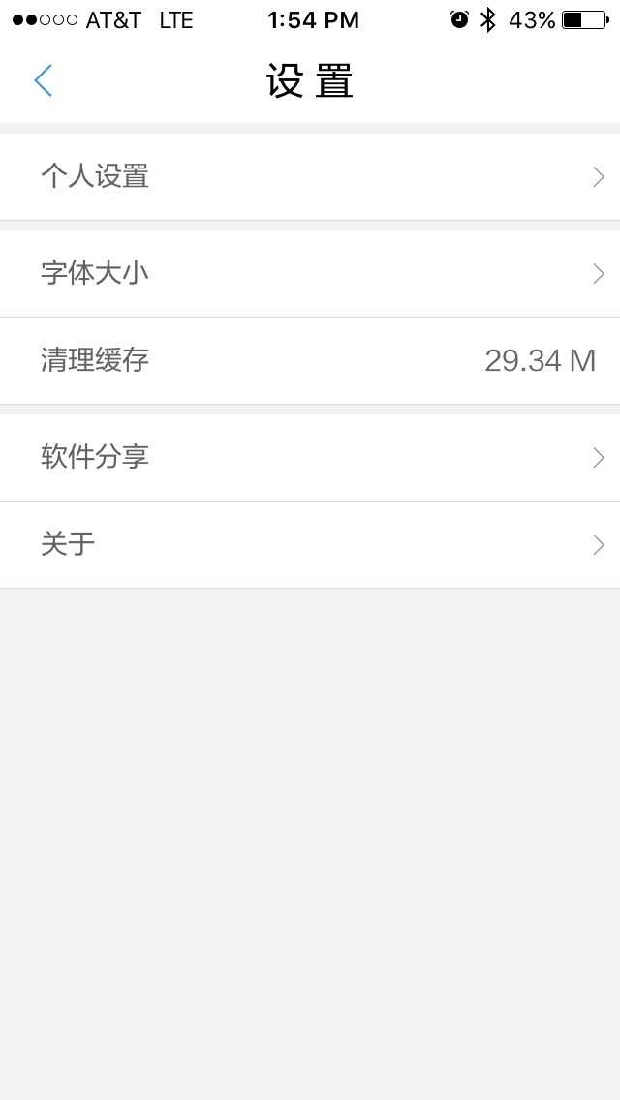
Xinhua News: User Settings
User Settings
Envelop = notifications history
Landscape image = turn images on/off
Gear = app settings
Heart = my thumbs up
Star = my favorite content
Comment = my comments
Question mark = my questions through microphone icon
Pen = give feedback about app
Set Up
Personal Profile Settings
Font Size
Clear Cache
Share App
About Xinhua News

Slide 16
Xinhua News Key Findings
Onboarding and Training
Onboarding instructions when the user first opens the app, or when new features are added
Home Screen
Carousel has nice transitions
Category dividers have a link within them letting user see more content than the top few that are shown
Search Tools
Allow users to speak their search terms
Show previous search terms at the bottom of search screen
Categories
Elegantly allows user to customize Categories
Navigation
Swiping left navigates to next category
Swiping right from within content navigates back/up in hierarchy
Swiping down from landing page updates content
Header and footer stay static
Below categories is list of upcoming live streams to schedule notifications for
Video Player
User has the ability to listen to audio only and turn off video
Bottom has Back button, leave comment, read comments favorites, share, font size
This is hidden on swipe up and revealed on swipe down

Slide 17
Continued Xinhua News Key Findings
Categories
“Recommendations” category serves content based on user preferences
“Location” category has tabs/button tags for refining types of content
Five articles listed at a time. Then “read more” at the bottom of the category
Photos
User can select speaker icon to have caption and teaser machine read to them
This could be used for text content as well
Live Blog
Portfolio of Images, video, and text from on-site.
Some of the teaser content shows several images from the live blog.
User Settings
Give users the ability to see the Likes, Comments, and Favorites they’ve marked

Slide 18

XimalayaFM

Slide 19
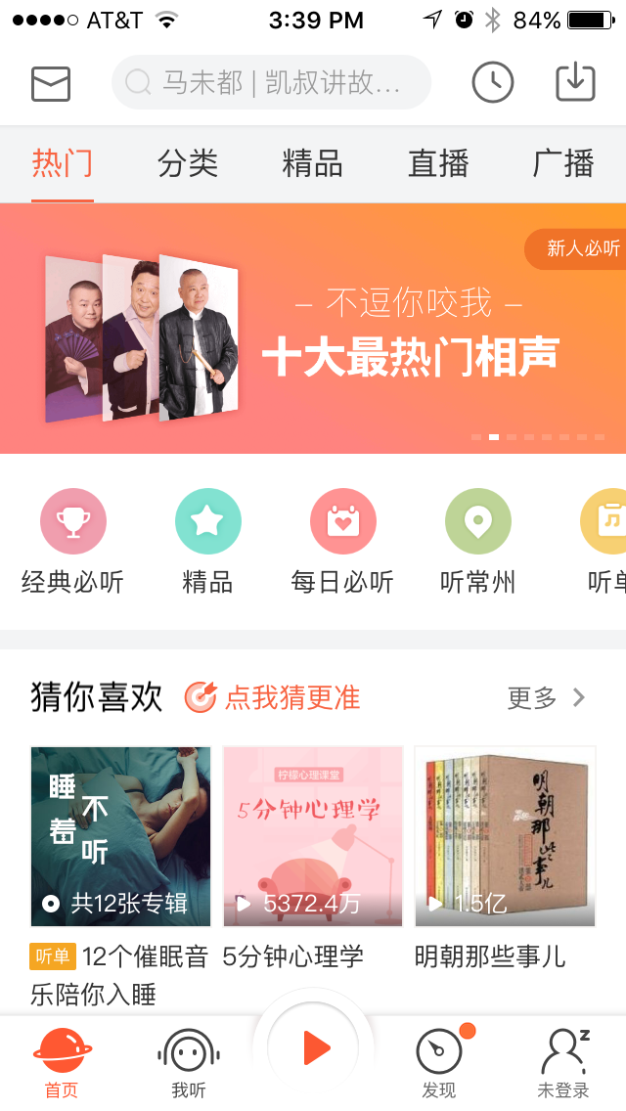
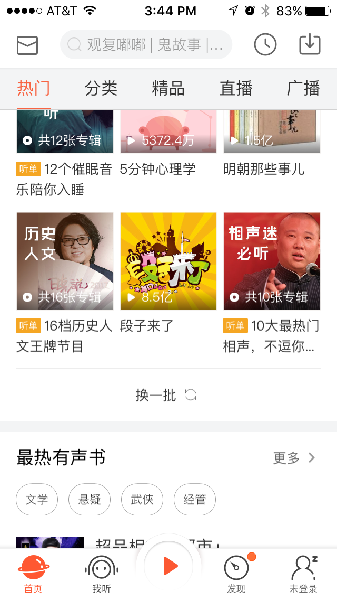
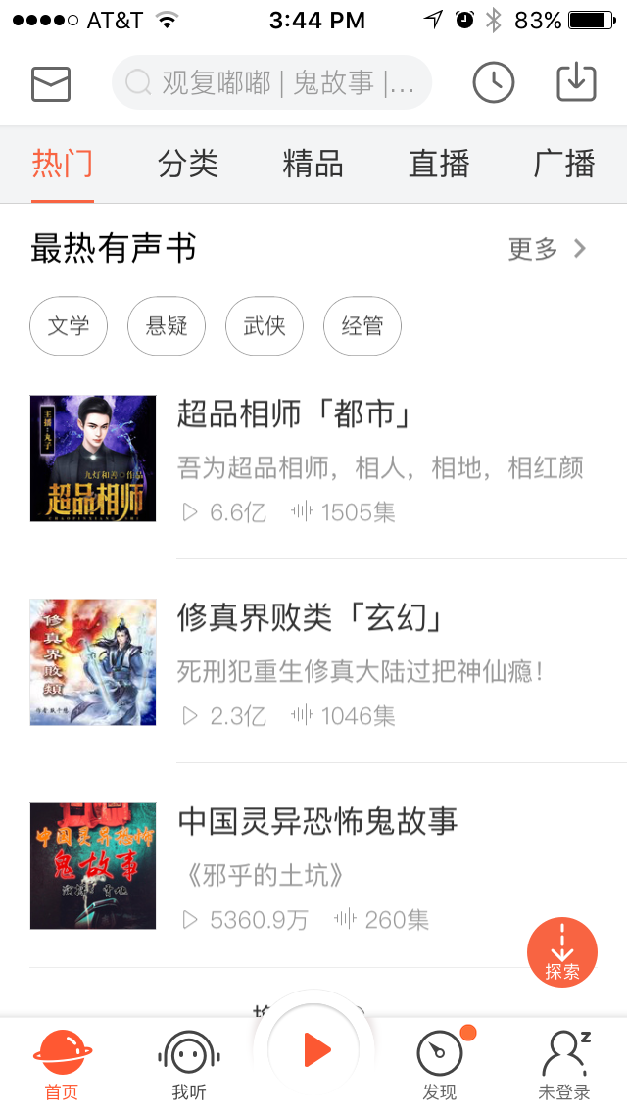
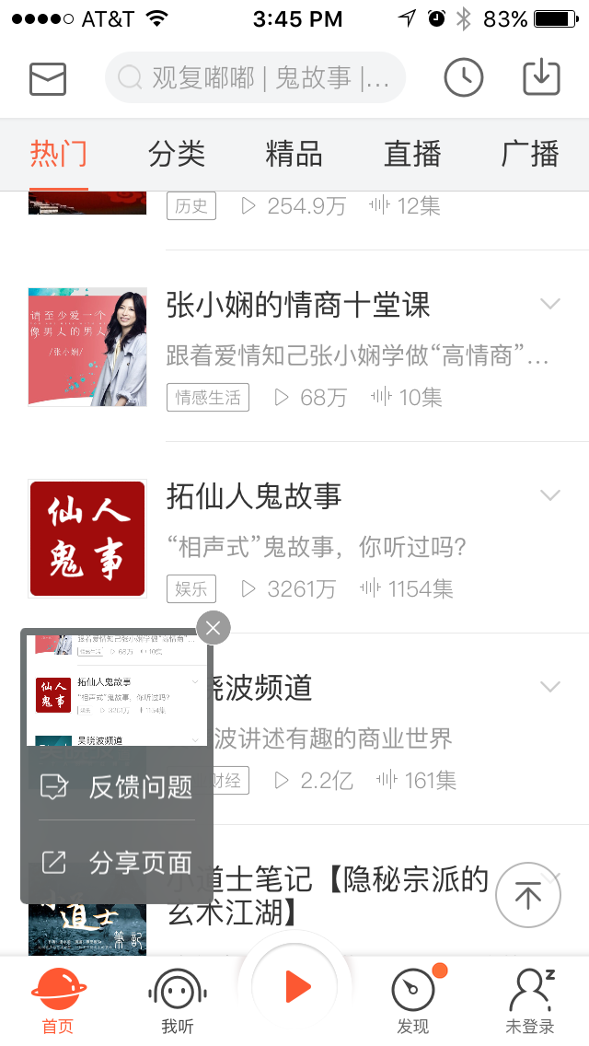
XimalayaFM: Home Screen
Home Screen – What’s Hot
Promos for different content available in this app – paid for by provider.
Middle row of icons
Trophy = “Classic” content
Star Icon = Hot content
Most popular
3 images of default content
Black text = “you may like”
Orange text asks user to self identify so app can recommend content better.
Top black text = Sub-categories such as audio books, or parenting
Text buttons are tags for further refining
A green icon on a thumbnail (not shown) indicates the series has completed
Note the screen that pops up when scrolling down.
Pop up is for giving feedback or sharing
Next to image
Black text = category
Parentheses = teaser
Box = category
Triangle = number of audio plays
Wave form = number of episodes
Note “go to top” icon in lower right

Slide 20
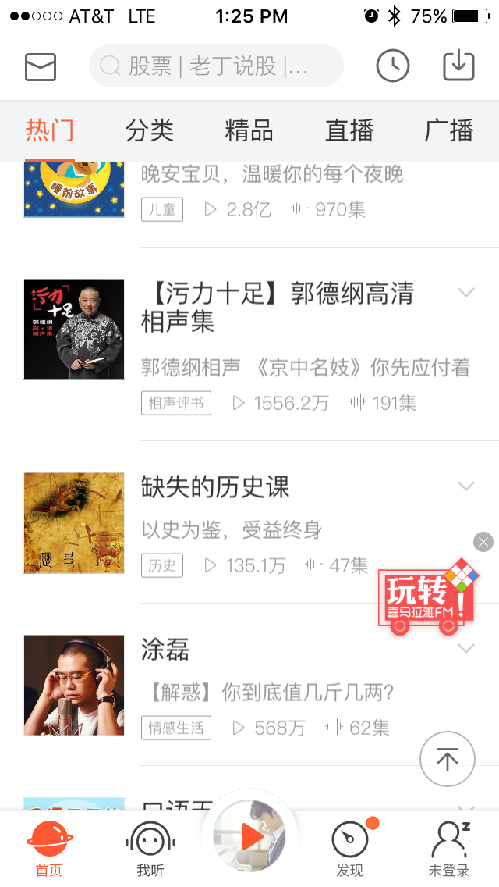
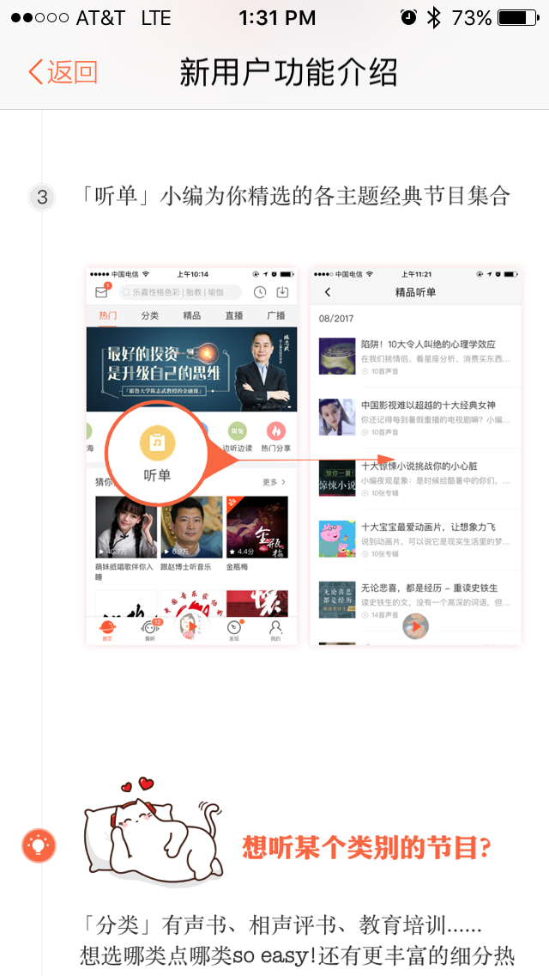
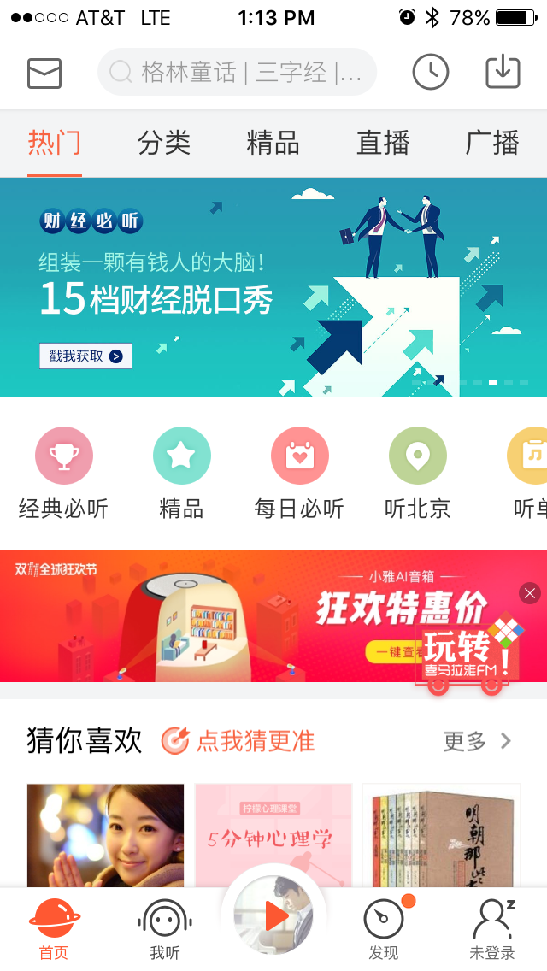
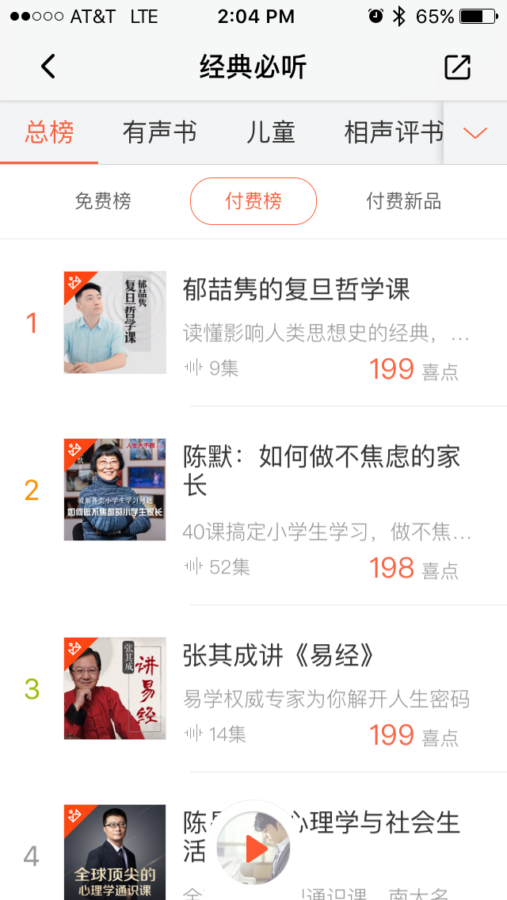
XimalayaFM: Home Screen
Small hovering train icon is a link to pop-up training screens
Categories across the top:
Trending
Music
Books
Podcasts
Features for new users
Be careful using the brand (like their cat) throughout
The VOA brand is powerful and well regarded, but we can’t splash it everywhere because we don’t users to be scared to use it.
Trophy = “Classic” content
Star Icon = Hot content.
Third Category screen (not shown) has icons for content:
Most popular
Newly available
For members only (commercial free)
Audio books
Shopping cart
Images for new content being promoted
Followed by list of daily selections
“Classic” content (must listen)
List of categories across the top:
Books
For children
Talk show
etc.
Dropdown shows all categories that you can choose from
Three tabs list free and for-purchase content

Slide 21
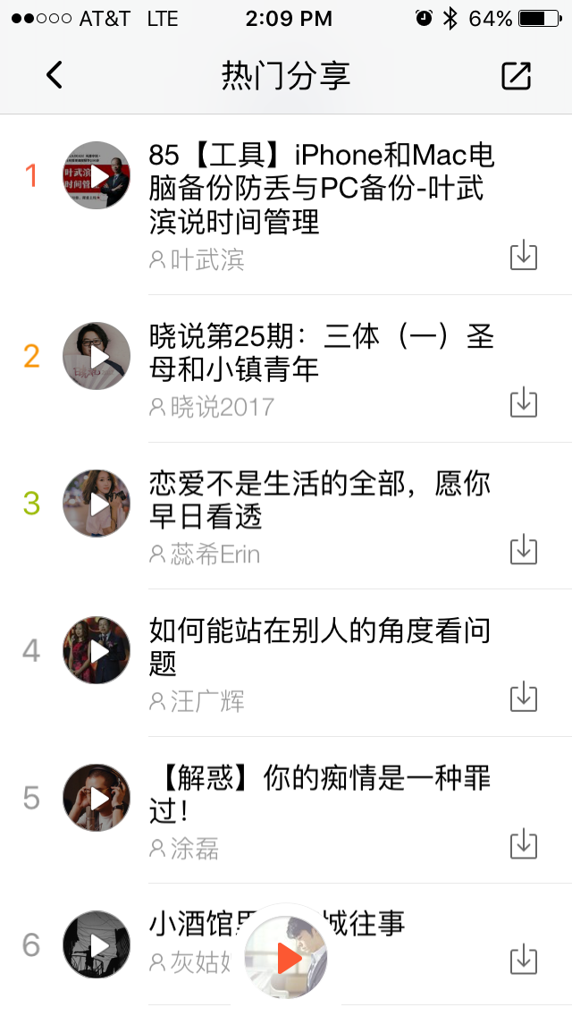

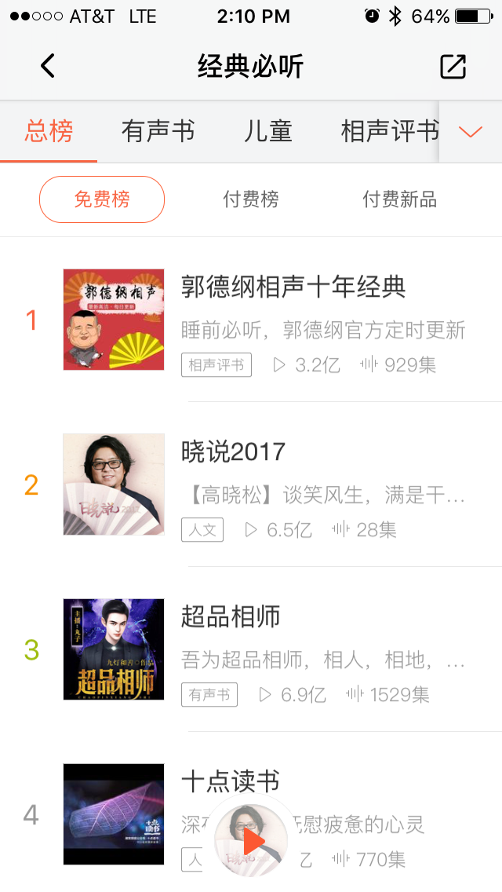
XimalayaFM: Audio Player
Audio Player
There are multiple access points for bringing up audio content.
Once clicked, the image in the audio player triangle icon changes to show the current audio in the player.
Clicking the audio player triangle icon brings up the player.
On initial load (not shown) a little training icon appears showing how to use the player.
Clicking the down arrow in the upper left closes the player but leaves the audio playing.
New image in the audio player icon showing current content being played.
User can browse while audio is playing.

Slide 22
XimalayaFM Key Findings
Categories
On “Recommended” content categories is a prompt for self-identifying to help app recommend content
Some categories have tabs/button tags for refining types of content
Audio Player
Once content is selected, the image in the audio player icon changes to show the current audio in the player
Clicking the down arrow in the upper left closes the player but leaves the audio playing – this is similar to Aparat
User can browse while audio is playing
Pop-ups
Upon scrolling down user is prompted with a pop-up for giving feedback and sharing
Small hovering train icon is a link to pop-up training screens
Transitions
XimalayaFM has a lot of interesting animations and transitions for repurposing

Slide 23

Toutiao (Headlines)

Slide 24
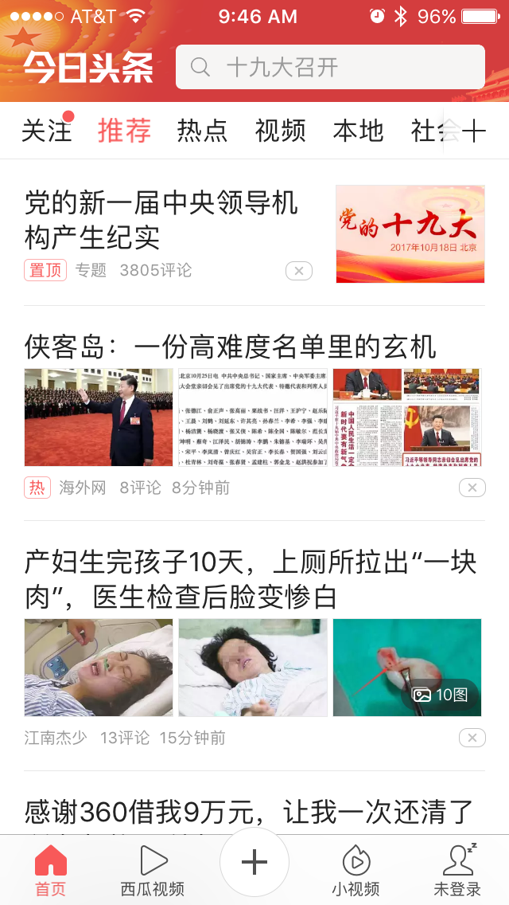
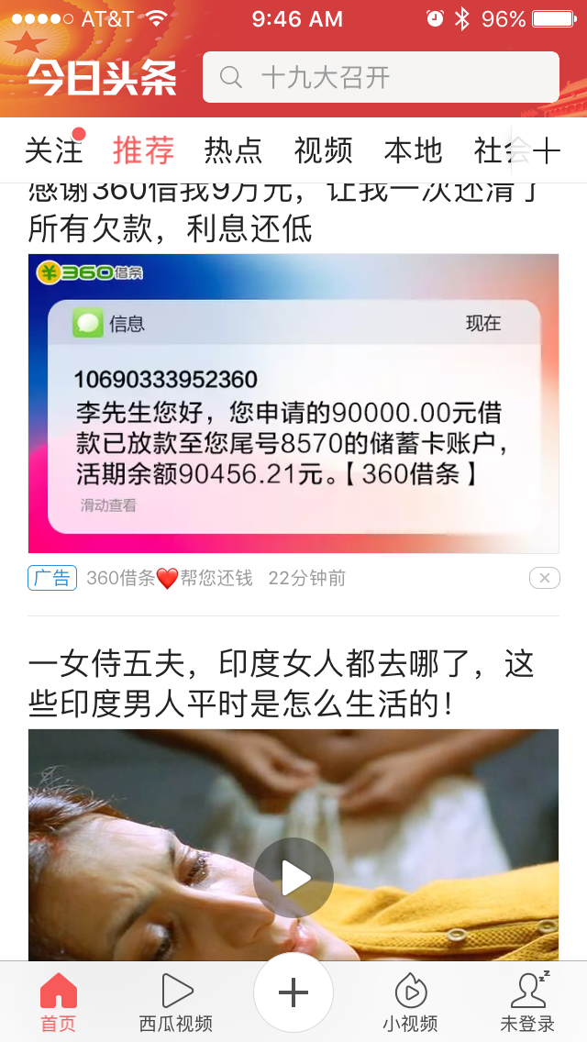
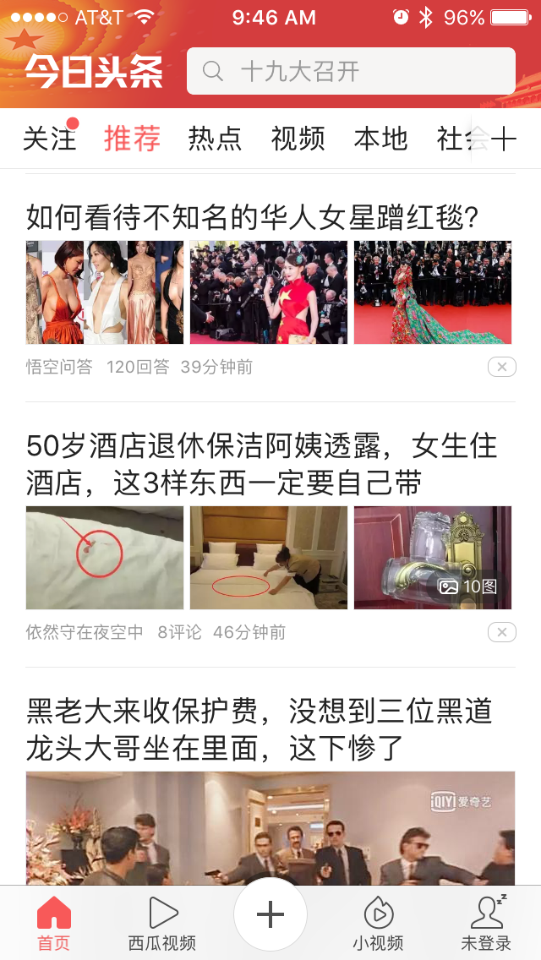
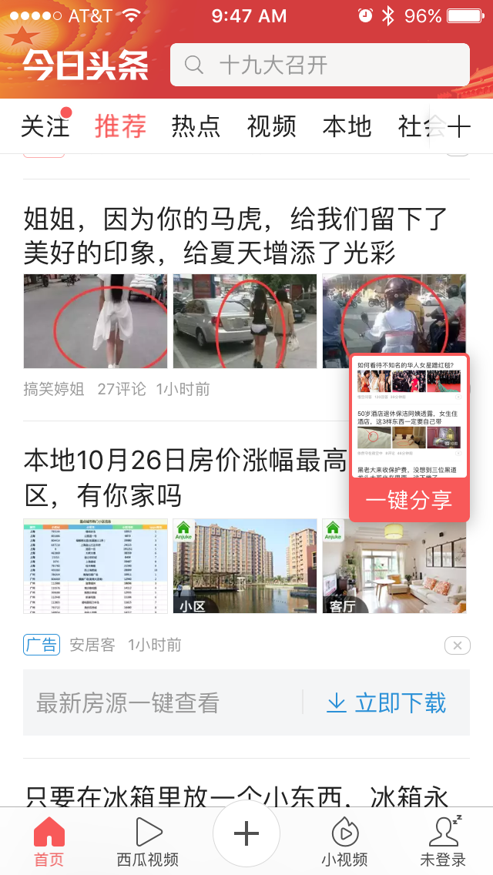
Toutiao: Home Screen
News, Food, Animals, Travel, Entertainment, Military, Sports, Technology, Finance, Health, etc.… + Let’s you edit and reorder Categories
First Category lists all of the agencies / person / that have channels that I’m following
Red indicator = new content available
Swiping down updates content:
“The people you are following have X udpates”
Recommendations
Swiping down updates content:
“Today’s recommendation engine has 8 updates”
Meta-data on images
Title
Poster
Follow
Rate the video
Download video
Channel owner
Number of comments
Date / time of post
Pop up
Generated after doing screen shot
Allows user to share through WeChat – Instagram does this as well
Embed the URL in the image?

Slide 25
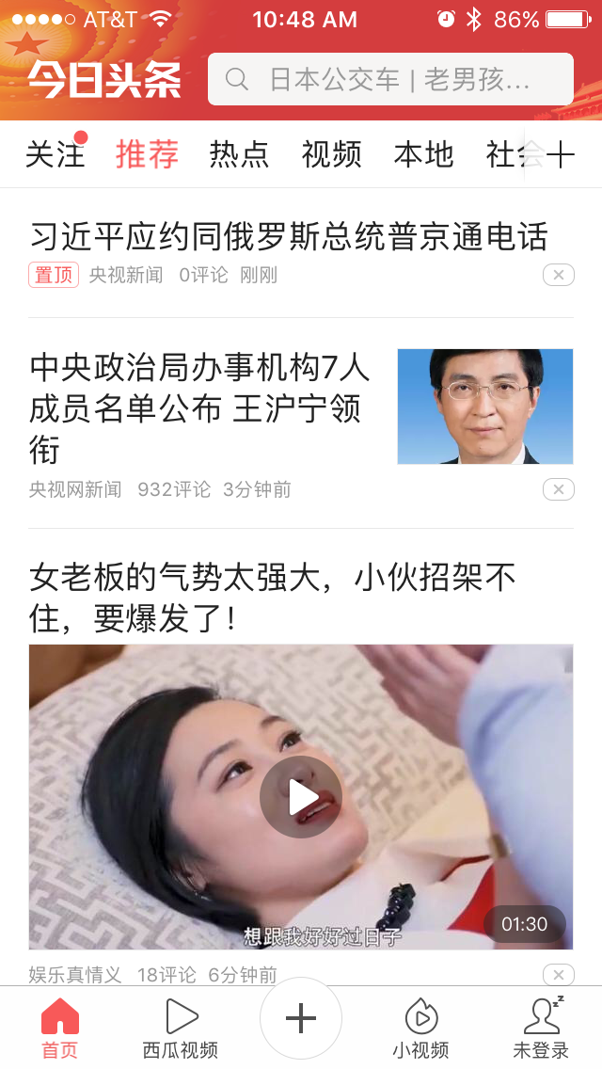



Toutiao: Related Content
Related Content
Article Content
Text only
Article Content with Image
Meta Data:
Title
Agency
Orange box = Follow
Image
One sentence news
Byline – person responsible for article
MZ015 = person’s ID
three grey boxes = related topic / tags (not shown)
Likes
Don’t Like
Across the bottom:
Comment / View Comments / Favorite / Share

Slide 26
Toutiao Key Findings
Loading New Content
Swiping down updates content:
“The people you are following have X udpates”
or
“Today’s recommendation engine has 8 updates”
Pop-up
When user takes a screen shot they are prompted to share the image – could be useful to take a picture of text, share it, and bypass censors

